Slide 1

Computer Graphics and Game Development
Inkscape 2
2016 Fall

Slide 2
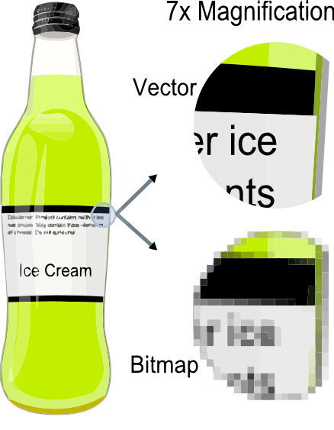
Images versus Vector Graphics
Vector Graphics:
Consist of shapes (dot, line, triangle, square etc.)
Zoom in w/o blurring
Easy to add/delete components
Bitmap (Images, picture, photo)
Consist of pixels
From camera, imaging devices
Hard to add/delete components
Getting blurry when zoomin

Slide 3
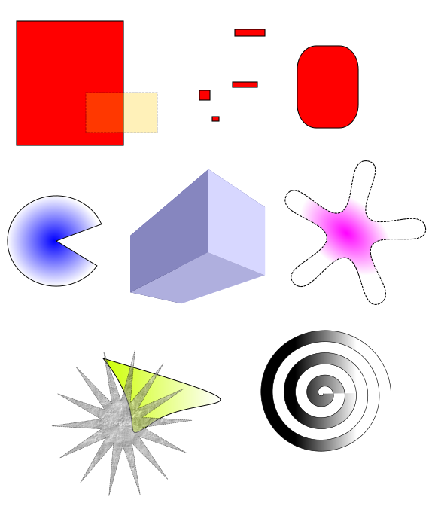
Inkscape: Basic Shapes

Slide 4


Inkscape Arts

Slide 5

Design PacMan in Inkscape
Highlight
Eyes
Face
Highlight
Shadow

Slide 6

Sketch Heart

Slide 7
Why learn computer graphics design?
Become an artist in the digital age, as a hobbyist or a pro.
Present yourself more efficiently.
Become a graphics designer in the future
Knows basics to get your software development started before asking pros to polish.

Slide 8
Exercise
Continue the PacMan project.
Try out one or a few projects at http://verysimpledesigns.com/vectors/

